Slide 1

Advance Software Engineering
Lecture 1
Introduction

Slide 2


Lesson Outline
Introduce the concept of software Engineering
Understand what Software Engineering is and why it is important
Understand why the development of different types of software systems may require different software engineering techniques.
Introduce the Software Engineering Process

Slide 3
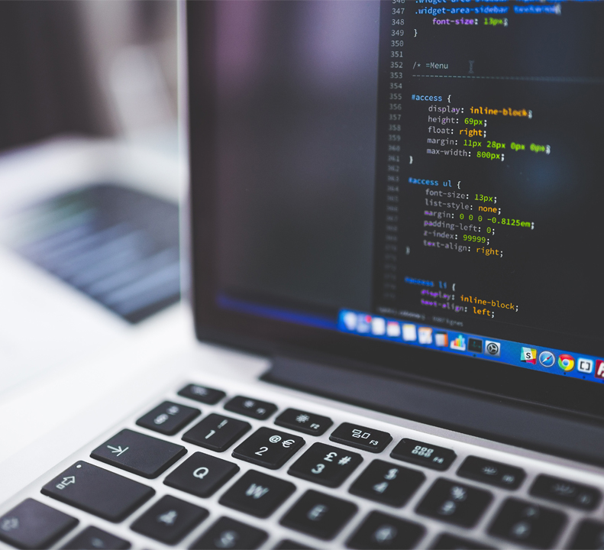
What is Software Engineering (SWE)
An engineering discipline that is concerned with all aspects of software production. from the early stages of system specification through to maintain­ing the system after it has been used. In this definition, there are two key phrases.
Computer science: is concerned with the theories and methods underlying com­puters and software systems, whereas software engineering is concerned with the practical problems of producing software.
Systems Engineering: is concerned with all aspects of complex systems development and evo­lution. It is composed of Software and Hardware

Slide 4



What is a Software
Software is more than a computer program, it includes:
documentation for future developers instruction manuals for users
configuration components that affect the program
installation/upgrade components to maintain the program.
In the long run, the use of software engineering methods to build software systems is cheaper than just write individual programs.
Installation Package
Code
Documentation
Recent Version
Configuration Details
Self Update/Installation Code

Slide 5
Software Engineering process: A sequence of activities that leads to the production of a software product.
In Reality
you are not building something for yourself
you have to understand/agree what someone else wants
you are not building something by yourself
you have to work with others - in different countries even
you are not building it for people like yourself it has to work for ‘real humans’, not computer experts
you are not working on code you wrote yourself
you have to figure out how the hell is this stupid code working

Slide 6
Software Engineering Activities
Software Specification: customers and engineers define the software that is to be produced and the constraints on its operation.
Software development: the software is designed and programmed.
Software Validation: the software is checked to ensure that it is what the customer requires.
Software Evolution: the software is modified to reflect changing customer and market requirements.

Slide 7

Software Process Models
Waterfall Model It is a linear and sequential approach to software development and project management. Separates the process activities into phases represented as requirements specification, software design, implemen­tation, testing, and so
V-Model Called also Verification and Validation Model, emphasizes the relationship between development stages and corresponding testing stages.
Incremental Model
This model focuses on delivering parts of the software as they are completed, rather than waiting until the entire system is finished Boehm’s Spiral Model
Introduced by Barry Boehm, it is a risk-driven approach to software development and project management. Reuse-oriented software engineering Model (ROSE) focuses on maximizing the use of existing software components and systems to build new software applications.

Slide 8
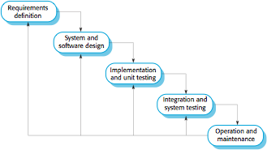
Waterfall Model
This Model fits for projects with well-defined requirements and a low likelihood of change.

Slide 9
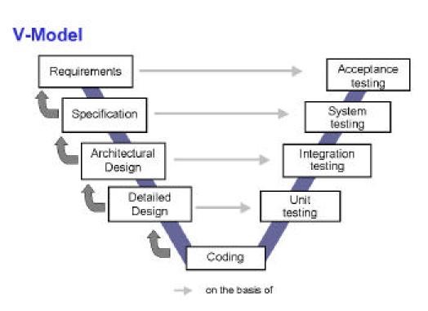
V-Model
The development activities on the left side of the "V" are mirrored by corresponding testing activities on the right side

Slide 10
Issues related to Waterfall model and V-model
Needs stable and “perfect” requirements
Cant always anticipate what you are going to have to do
Does not account for revision or refactoring
Too inflexible and static
Depends on getting each stage exactly right

Slide 11
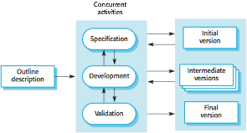
Incremental Model
The software is designed, implemented, and tested in small, manageable increments. Each increment adds functional capabilities to the software, allowing for partial delivery of the system at various stages throughout the development process.

Slide 12
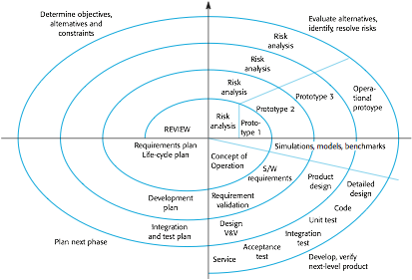
Spiral Model
The model combines elements of both iterative development and the Waterfall model, with a focus on continuous risk assessment and iterative refinement. The model is well-suited for complex and high-risk projects.

Slide 13
ROSE Model
The goal of this model is to improve efficiency, reduce development time, and enhance software quality by leveraging pre-existing, reusable components rather than creating components from scratch.
The system development process focuses on integrating these components into a system rather than new development.

